Slide 1

Student Performance Analytics Dashboard
DATA SCIENCE (24AD3107) Project Review-1
 | Under the Guidance of Ms.Prathusha Department of Computer Science and Engineering, KLH CSE Bowrampet Campus
Team Members 2420030097-Deepika 2420030565-Ashritha 2420030201-Srijan

Slide 2
Outline of Project Work
Focus
Introduction
Literature Survey
Challenges
Research Objectives
Conclusion & Future Work
References
Publications Details

Slide 3
Problem Statement
Student academic performance depends on several factors such as attendance, study hours and learning habits.
However, analyzing raw student data manually makes it difficult to understand:
How attendance is related to grades
How study hours affect academic performance
Which students need attention
Overall performance trends
Proposed Solution:
Develop LearnTrack, a data-driven dashboard that uses Exploratory Data Analysis (EDA), statistical analysis and interactive visualizations to identify patterns and relationships in student performance data.

Slide 4
Objectives
Analyze student academic datasets
Perform EDA on attendance, study hours and grades
Identify correlations between important academic factors
Visualize performance using charts and graphs
Compare student performance
Identify students who may need attention
Generate meaningful analytical insights
Support data-driven academic evaluation

Slide 5
Literature survey
Research Paper | Year | Techniques / Methods Used | Key Findings | Limitation / Gap
Lecture Attendance, Study Time, and Academic Performance: A Panel Data Study – Andrietti & Velasco | 2015 | Regression Analysis, Panel Data | Analyzed the relationship between attendance, study time and academic performance. Study time showed an important relationship with performance. (Taylor & Francis Online) | Focuses mainly on statistical/econometric analysis; does not provide an interactive student analytics dashboard.
Class Attendance and Academic Performance: A Panel Data Analysis – Latif & Miles | 2013 | Panel Data Analysis | Found a significant positive relationship between class attendance and grades after controlling for ability and effort. (Wiley Online Library) | Focuses mainly on attendance and examination performance rather than combining multiple student factors in a visual dashboard.
Class Attendance in College: A Meta-Analytic Review of the Relationship of Class Attendance With Grades and Student Characteristics – Credé et al. | 2010 | Meta-analysis, Correlation Analysis | Examined many studies and found a strong relationship between attendance and college grades/GPA. (Sage Journals) | Broad research review; does not provide an interactive system for analyzing individual student records.
Development of the Learning Analytics Dashboard to Support Students' Learning Performance – Park & Jo | 2015 | Learning Analytics, Data Visualization, Usability Testing | Developed a dashboard that collects learning data, analyzes it and visualizes information for easier understanding. (Journal of Universal Computer Science) | Dashboard focused mainly on online learning behavior; its pilot test did not show a significant impact on learning achievement.
Learning Analytics Dashboard: A Tool for Providing Actionable Insights to Learners – Susnjak et al. | 2022 | Learning Analytics, Descriptive Analytics, Predictive/Prescriptive Analytics | Reviewed learning analytics dashboards and highlighted the importance of providing actionable and understandable insights to learners. (Springer) | Many existing dashboards use mainly descriptive analytics; the study also discusses more complex predictive approaches that are beyond the simple EDA focus of LearnTrack.
LearningViz: A Dashboard for Visualizing, Analyzing and Closing Learning Performance Gaps – Pei et al. | 2024 | Data Visualization, Learning Analytics, Performance Gap Analysis | Developed an interactive dashboard for instructors to analyze student performance, compare groups and identify performance gaps using multiple visualizations. (Springer) | More comprehensive and course-specific than LearnTrack; includes detailed assessment/item-level analysis.

Slide 6
Problem Gap Identification
Existing systems:
Focus mainly on prediction
Often require complex ML models
May not provide simple visual analysis
Limited focus on relationships between attendance, study hours and grades
Data can be difficult for faculty to interpret
LearnTrack addresses this gap by:
Providing interactive analytics
Showing correlation patterns
Presenting student performance clearly
Making raw academic data easier to understand

Slide 7
Innovation, Creativity, and Novelty
Innovation:
Interactive student performance dashboard
EDA-based academic analysis
Correlation analysis between performance factors
Data-driven insights
Creativity:
Easy-to-understand visualizations
Modern dashboard UI
Student performance categories
Interactive filters and charts
Novelty:
Combines attendance + study hours + grades in a single analytical platform
Converts raw academic data into understandable insights
Provides faculty-oriented performance analysis
AI-generated analytical synthesis can be included as an additional feature

Slide 8
Feasibility and Project Plan
TIMELINE CHART FOR EACH PHASE OF YOUR PROJECT SHOULD BE THERE AFTER EXPLANATION
Technical Feasibility
Frontend: React / Vite
Programming: JavaScript
Data Analysis: Python / statistical methods
Charts: Interactive visualization libraries
Database: Firebase / relevant project storage
Deployment: Vercel
Version Control: Git & GitHub

Slide 9
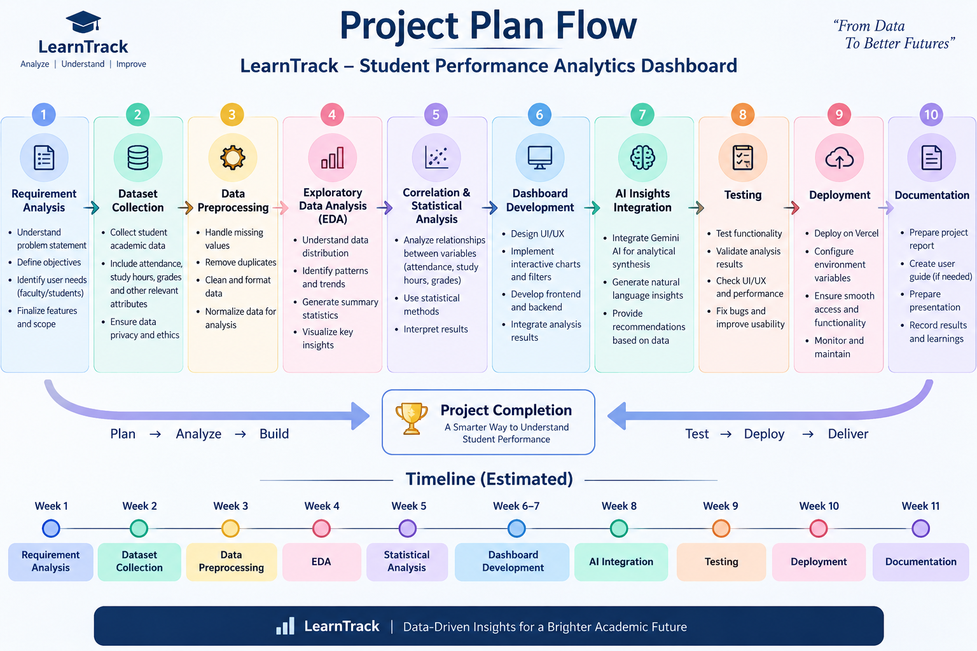

Slide 10
Project plan
Phase | Work
1 | Requirement Analysis
2 | Dataset Collection
3 | Data Preprocessing
4 | Exploratory Data Analysis
5 | Correlation & Statistical Analysis
6 | Dashboard Development
7 | AI Insights Integration
8 | Testing
9 | Deployment
10 | Documentation

Slide 11
THANK YOU

